Slide 1



Spring Framework Fast Track 2019
A complete of essential concepts and examples
Author: Erfin Feluzy & Wahyu Sudrajat
March 2019

Slide 2
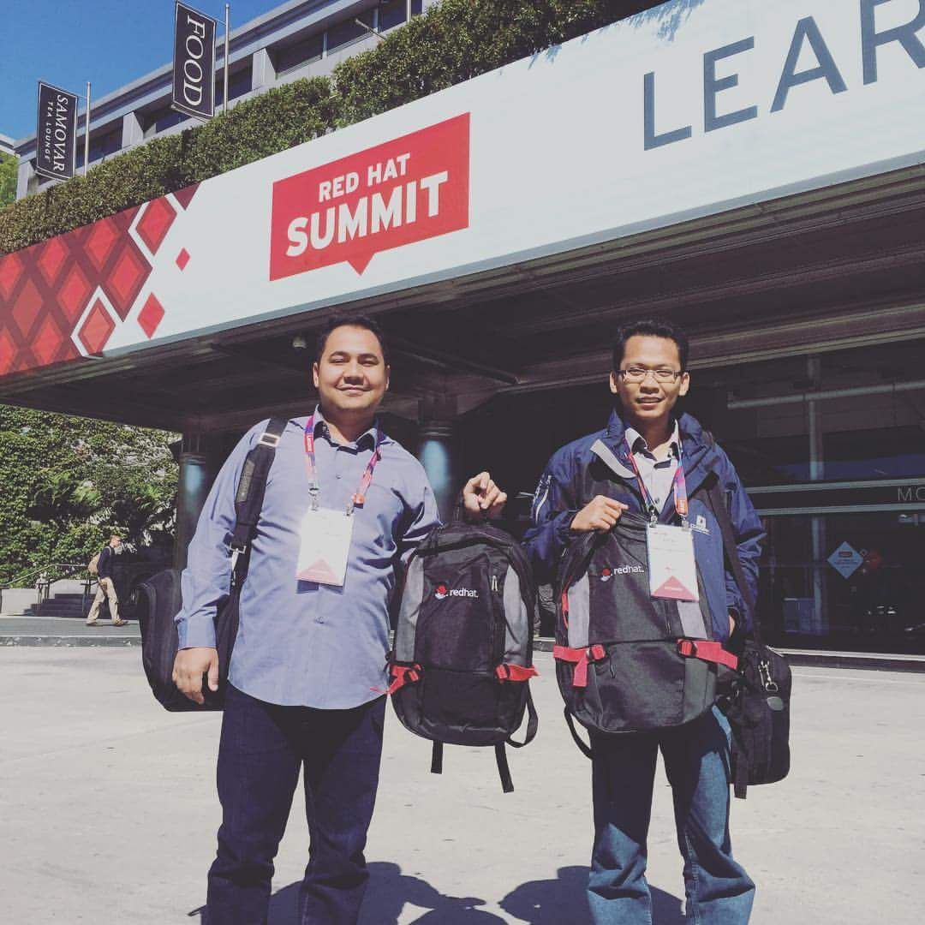
Profile
ERFIN FELUZY
11+ years professional experience in Java Programming (10+ years spring framework)
General Manager in Software Solution
Sr Middleware Solution Architect
WAHYU SUDRAJAT
8+ years professional experience in Spring
Linux master & Mathematician
Solution Architect in Software Solution

Slide 3
Agenda Day 1 (March 9, 2019)
09:00 – 10:00 : Spring Framework intro
10:00 – 10:30 : Spring Boot intro (Hands-On)
10:30 – 11:00 : Basic build with Maven (Hands-On)
11:00 – 12:00 : Hands-On prerequisite setup
12:00 – 13:00 : Ishoma
13:00 – 14:00 : Spring web MVC (Hands-On)
14:00 – 15:00 : Spring Data Database (Hands-On)
15:00 – 16:00 : Spring Web Service REST producer (Hands-On)
16:00 – 17:00 : Spring Web Service SOAP producer (Hands-On)

Slide 4
Agenda Day 2 (March 16, 2019)
09:00 – 10:00 : Spring Web Service REST consumer (Hands-On)
10:00 – 11:00 : Spring Web Service SOAP consumer (Hands-On)
11:00 – 12:00 : Spring JMS Publisher & Subscriber (Hands-On)
12:00 – 13:00 : Ishoma
13:00 – 14:30 : Lab : Use Case 1
14:30 – 16:00 : Lab : Use Case 2
16:00 – 17:00 : Recap & Closing

Slide 5
What is Spring?
Back then, enterprise application commonly use a technology called Enterprise Java Bean (EJB) which relatively heavy and tightly depend on enterprise solution such as: Application Web Server(s).
What is Spring?
An open-source framework.
An alternative to heavier enterprise Java technologies.
Addresses the complexity of enterprise application development, thus it “Simplifies Java development ”
https://www.youtube.com/watch?v=a14xfNV-UIs

Slide 6
Spring is Non-Invasive
What does that mean?
You are not forced to import or extend any Spring APIs
An invasive framework takes over your code.
Anti-pattern: (sample of invasive framework)
EJB forces you to use Java Naming and Directory Interface (JNDI), commonly found at enterprise application framework
Struts forces you to extend Action, ActionForm
Invasive frameworks are inherently difficult to test. You have to stub the runtime that is supplied by the application server.
https://www.slideshare.net/pmanvi/spring-framework-overview-ppt-3068245

Slide 7
Benefit of Using Spring
Spring is a Framework which help to solve common software developing problems with Java programming language, such as:
Manage lifecycle of Java classes (called beans)
Dependency Injection framework
Provide Data Access which commonly works through Java Database Connectivity (JDBC), Object-Relational Mapping (ORM), etc.
Provide Spring-MVC which standardize patterns and structure to develop Web Application
more…
https://www.youtube.com/watch?v=gq4S-ovWVlM

Slide 8
Dependency Injection (DI)
Wikipedia definition of DI:
“In software engineering, dependency injection is a technique whereby one object (or static method) supplies the dependencies of another object. A dependency is an object that can be used (a service)”
https://medium.freecodecamp.org/a-quick-intro-to-dependency-injection-what-it-is-and-when-to-use-it-7578c84fa88f

Slide 9
What is Spring Boot?
Although Spring does simplify Java development process, it can give programmers an adversity while developing an application.
Boiler plate configuration
Programmer writes a lot of codes (configurations) to do minimal task
Takes time to have Spring application up and running
Spring Boot offers the solution for those problems. Spring Boot is a suite of pre-configured framework and technologies and it is a shortest way to have Spring application up and running.
https://www.youtube.com/watch?v=LLfZ2g2JaIc

Slide 10
Hand-On Prerequisites Setup
Oracle SDK 8+, you might also use OpenJDK, make sure to have JDK installed instead of JRE
Java IDE, Eclipse 2018-12 is preferred
Eclipse by default comes with Apache Maven embedded
Properly setup Java Runtime Environment (JRE) on Environment Variable (Windows), or PATH variable (Unix based)
Lombok Project for Simplify POJO

Slide 11

Spring Boot Hands-On
Spring Boot Intro

Slide 12
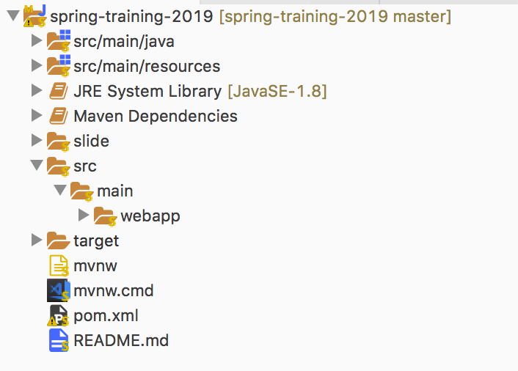
Maven Common Project Structure
Java files here
Application properties files (config) here
Web files here (jsp or html)

Slide 13
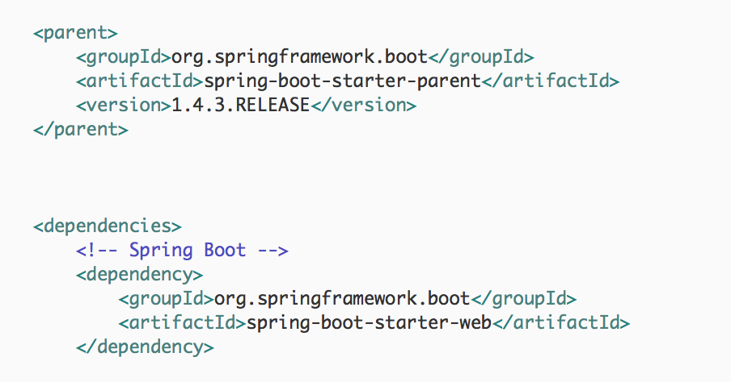
Spring Boot’s pom.xml
Spring boot parent artifact
Based on web MVC

Slide 14
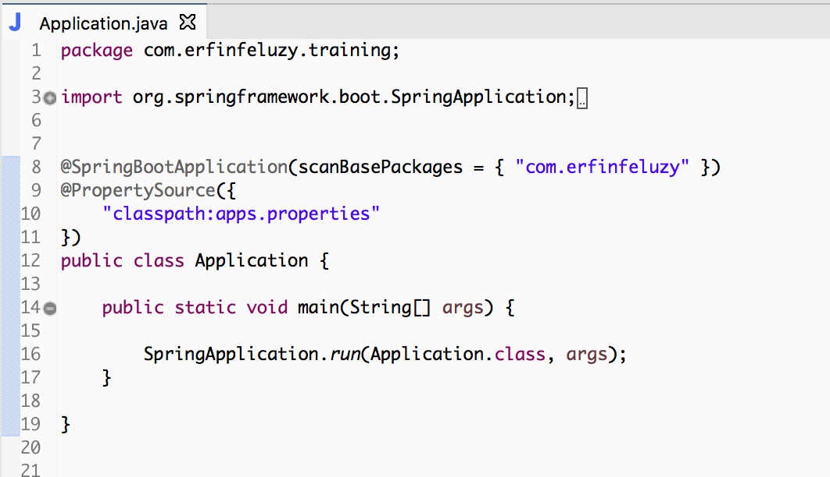
Spring Boot Starter
Scan all spring bean inside base package
Spring boot custom configuration.
Eg: server port, database, etc
Spring boot custom configuration.
Eg: server port, database, etc

Slide 15
Maven Hands-On
Basic Build with Apache Maven

Slide 16
Apache Maven
Maven is a software management and comprehension tool based on the concept of Project Object Model(POM). It can manage project build, reporting and documentation, from a central piece of information. Basically, this tool can be used as both, a build tool (just like ANT tool), as well as a project management tool. However, in this article we will use it just for building our project.
Basic usage of maven are:
$> mvn clean
$> mvn compile
$> mvn install
https://medium.com/@himanshuagarwal1395/getting-started-with-apache-maven-hello-world-eccb278a262a

Slide 17

Spring Web MVC Hand-On
Spring Boot + Spring Web

Slide 18
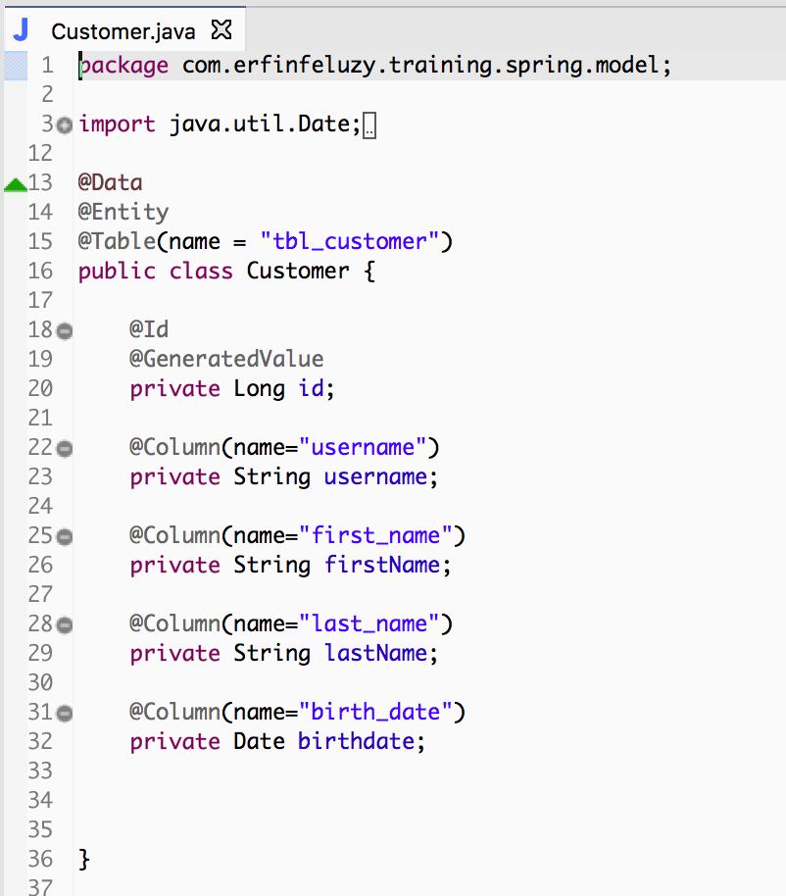
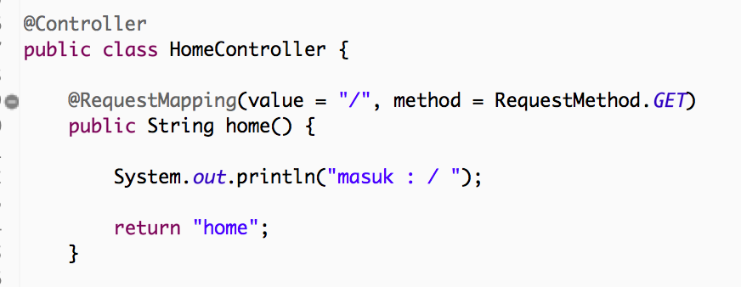
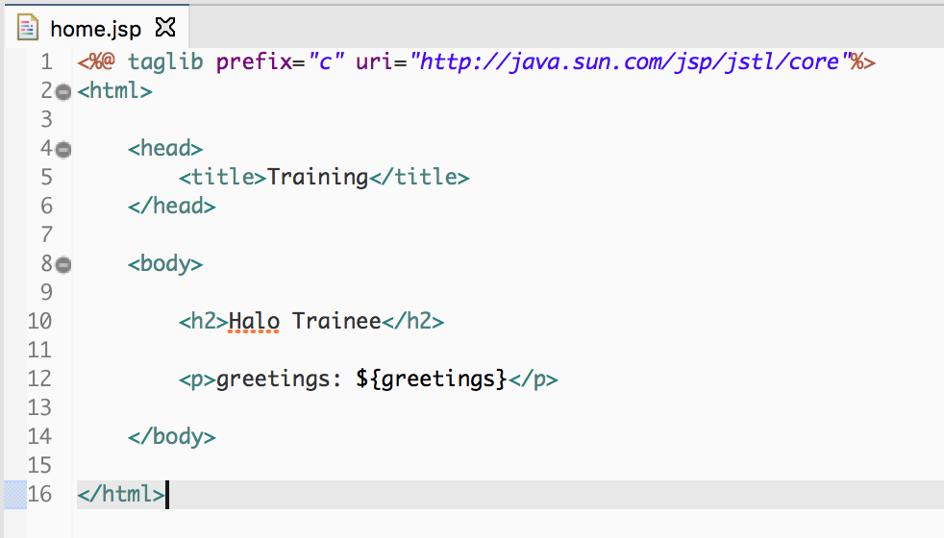
Spring MVC (Model-View-Controller)
controller
view
model

Slide 19

Spring Data Hand-On
Spring Boot + Spring Data

Slide 20

Spring Web Service REST Producer Hand-On
Spring Boot + Spring Web

Slide 21

Spring Web Service SOAP Producer Hand-On
Spring Boot + Spring Web

Slide 22
Spring Web Service REST Consumer Hand-On
Spring Boot + Spring Web

Slide 23
Spring Web Service SOAP Consumer Hand-On
Spring Boot + Spring Web

Slide 24
Spring JMS Publisher & Subscriber Hand-On
Spring Boot + Spring JMS

Slide 25
Lab – Use Case 1
Create Multiple Backend Web Services

Slide 26
Lab – Use Case 2
Create Microservices apps with Spring Boot

Slide 27
Recap & Closing

